Slide 1
Introduction to Xamarin Oleksandr Krakovetskyi CEO, DevRain Solutions @sashaeve, alex.krakovetskiy@devrain.com

Slide 2
About
CEO of DevRain Solutions – software development.
Microsoft Regional Director.
Microsoft Windows Phone Most Valuable Professional (Windows Platform Development).
Best Professional in Software Architecture (Ukrainian IT Award).
Ph.D. in Computer Science.
Speaker and blogger.

Slide 3
Agenda
Platform Convergence Journey and UWP
Xamarin Growth
Microsoft + Xamarin = Complete Mobile Ecosystem
What’s new in Xamarin 2016
Q&A

Slide 4
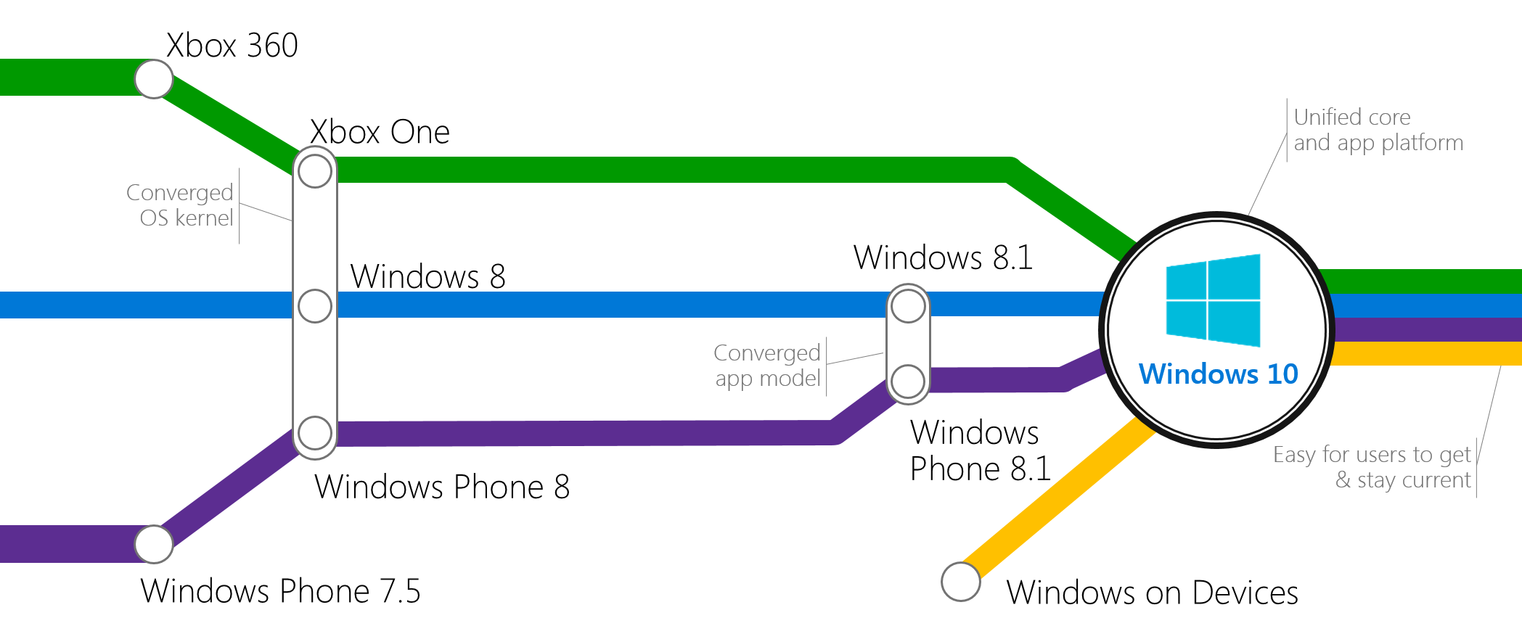
Platform Convergence Journey

Slide 5

Universal Windows Platform
Windows Platform
Web Platform
Universal Windows 8 Apps (C++/C#/JS)
Microsoft Edge HTML Engine
Universal Windows 10 Apps (C++/C#/JS)
Surface Hub
Desktop
Cordova Tooling (HTML/JS)
Project Centennial (Classic Apps)
Hosted Web Apps (HTML/JS)
Universal Windows Platform
IoT
Xbox
Middleware Platforms
Other Mobile Platforms
Middleware Partners (e.g., Xamarin)
Holographic
Mobile
Project Astoria (Java/C++)
Game Engine Partners (e.g., Unity)
Project Islandwood (Objective C/C++)

Slide 6
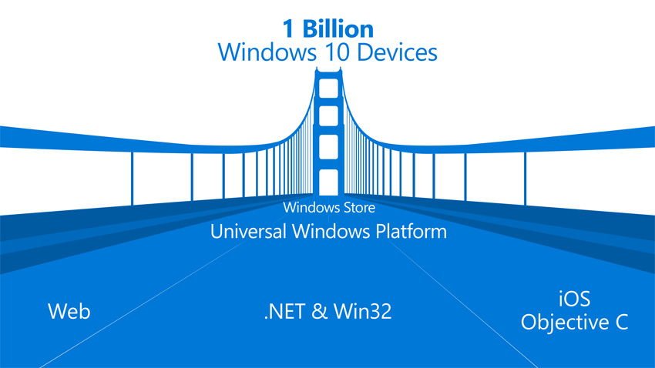
Windows Bridges
Desktop Bridge (Project Centennial)
Hosted Web Apps (”Project Westminster”)
Mobilize.Net’s Silverlight Bridge
Windows Bridge for iOS (“Project Islandwood”)
Windows Bridge for Android (”Project Astoria”)
https://developer.microsoft.com/en-us/windows/bridges

Slide 7
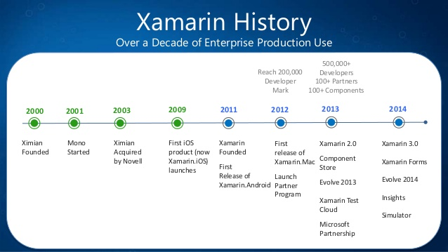
Xamarin History
Microsoft and Xamarin Expand Global Partnership (November 12, 2014)
Microsoft Agrees to Acquire Xamarin (February 24, 2016)

Slide 8
Anything you can do in Objective-C, Swift, or Java can be done in C# and Visual Studio with Xamarin.

Slide 9
Drawbacks
Price. It’s not cheap.
Minor bugs & updates issues.
Applications binaries size is bigger.
Mac machine is required.
Harder to find Xamarin developers.
Xamarin.Forms are not suitable for all project types.
Not the best choice for rich UI apps with poor business logic.
Small community comparing to iOS/Android/.NET but it’s growing.
Suitable only for new apps.
Customers are afraid of cross-platform tools.

Slide 10
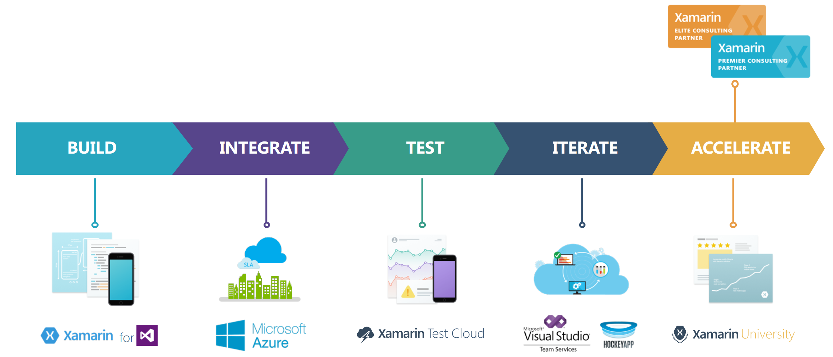
Complete Mobile Ecosystem

Slide 11
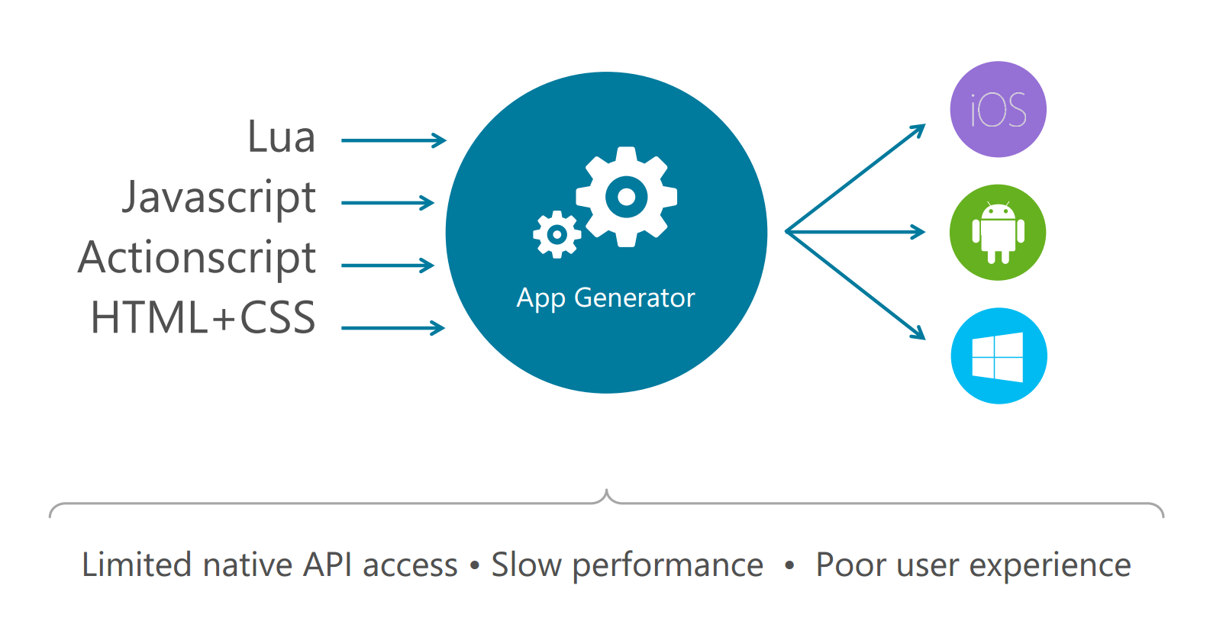
Write Once, Run Anywhere

Slide 12
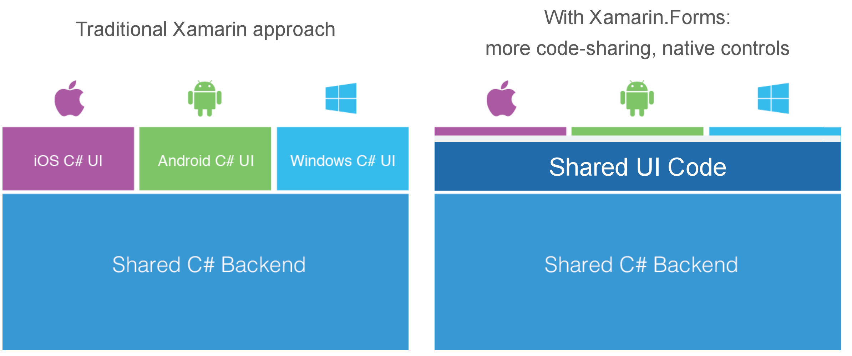
Code Sharing Architectural Approaches

Slide 13
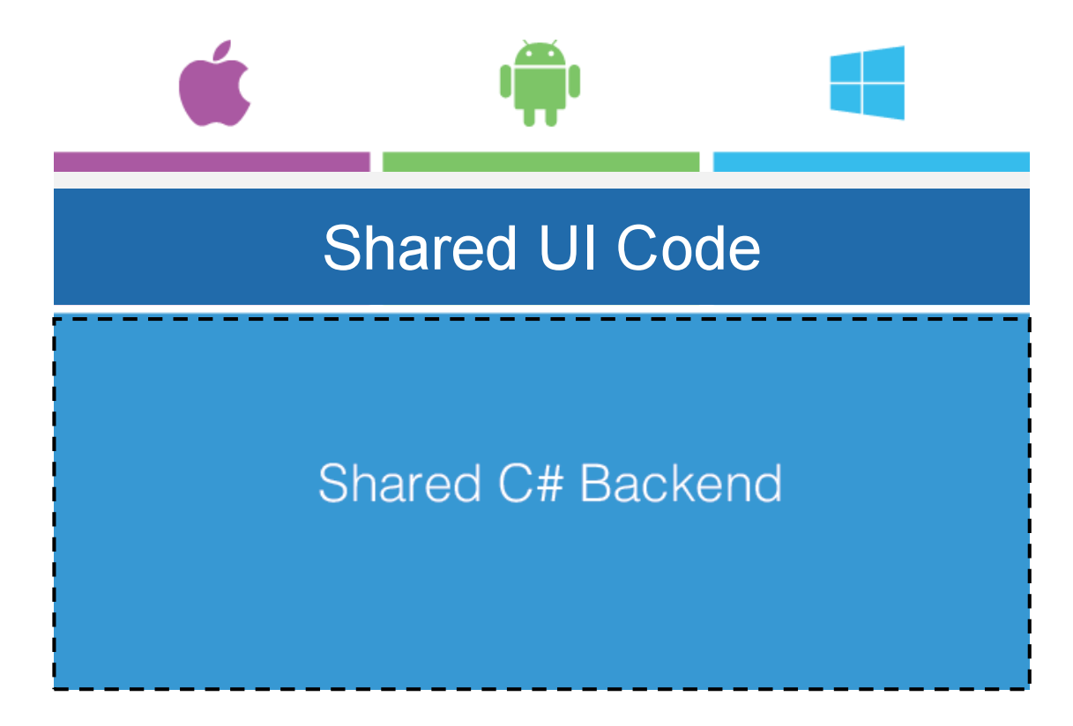
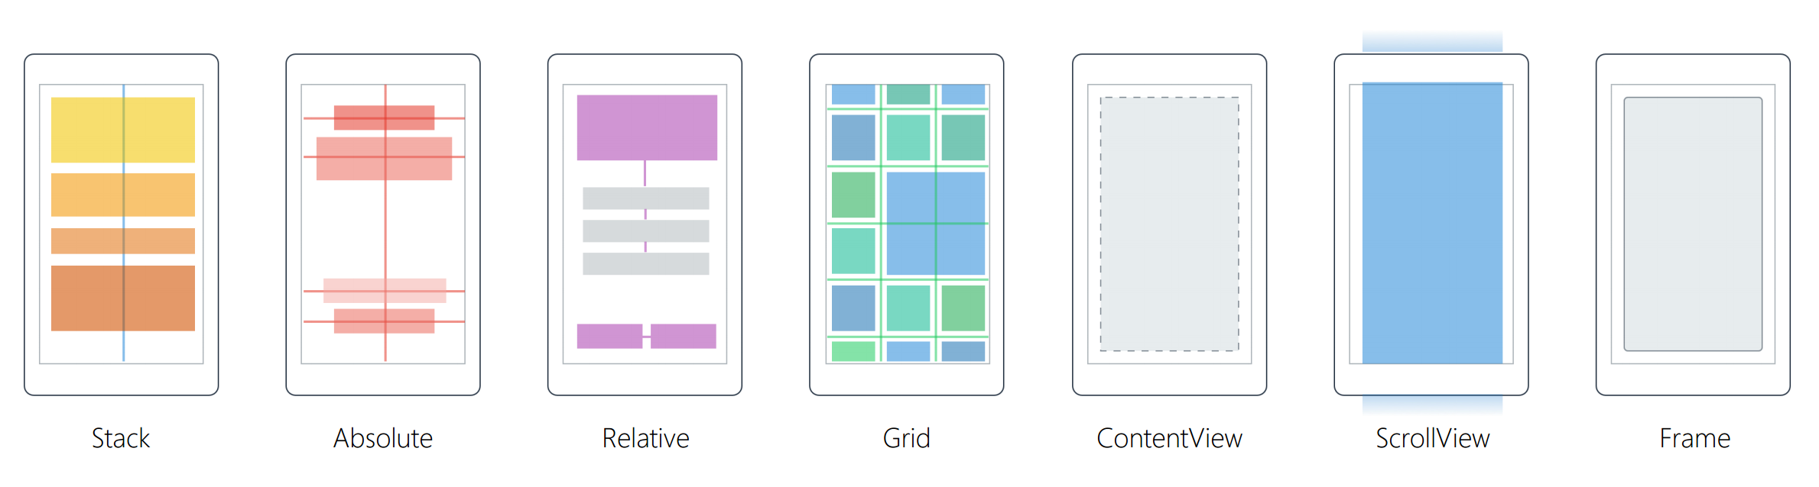
Xamarin.Forms
40+ Pages, Layouts, and Controls
Build from code behind or XAML
Two-way Data Binding
Navigation
Animation API
Dependency Service
Messaging Center

Slide 14
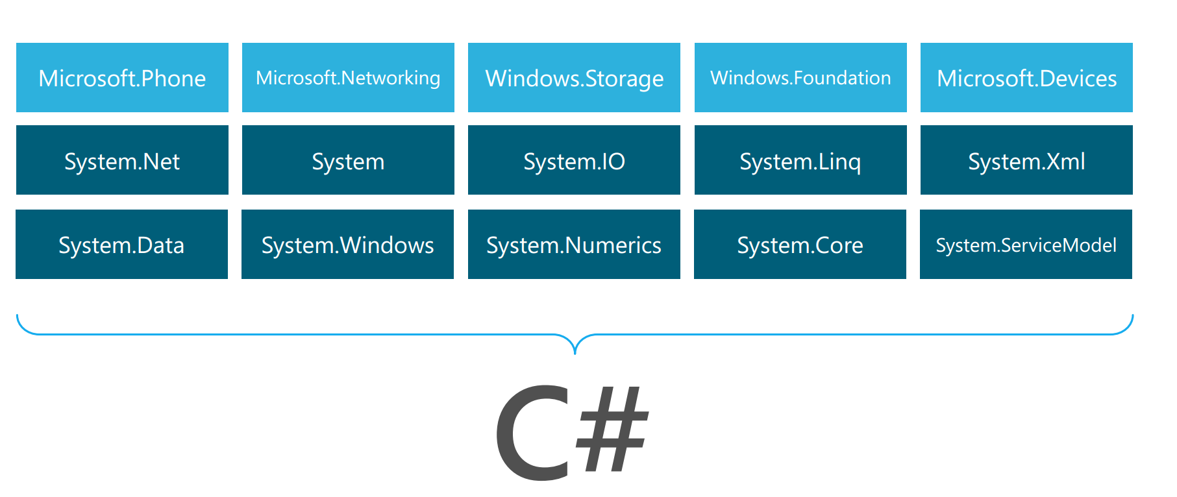
Windows APIs

Slide 15
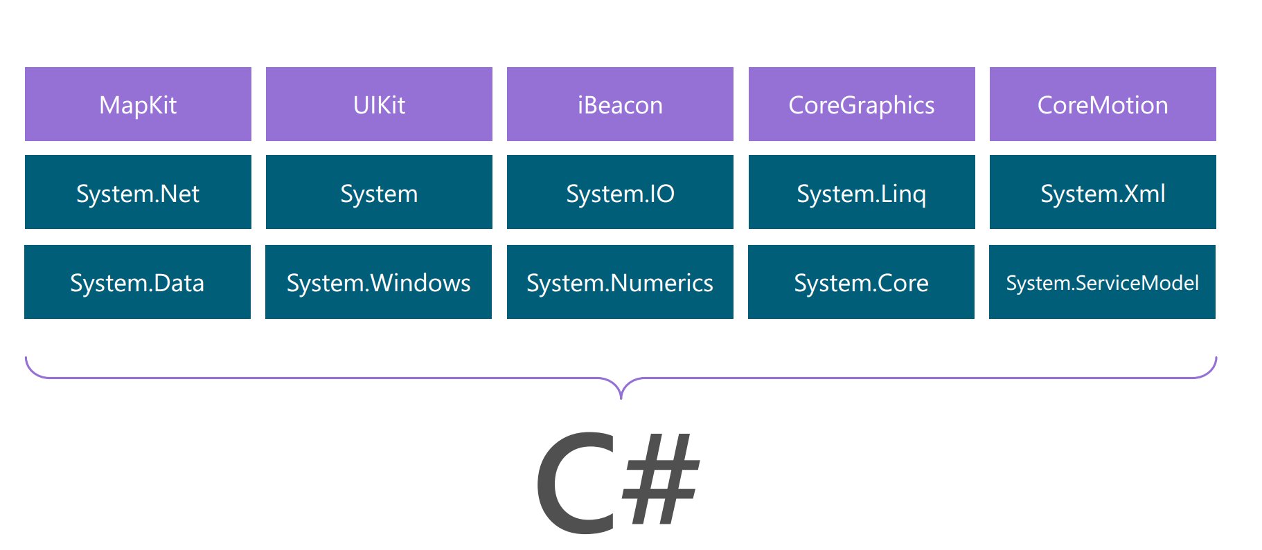
iOS – 100% API Coverage

Slide 16
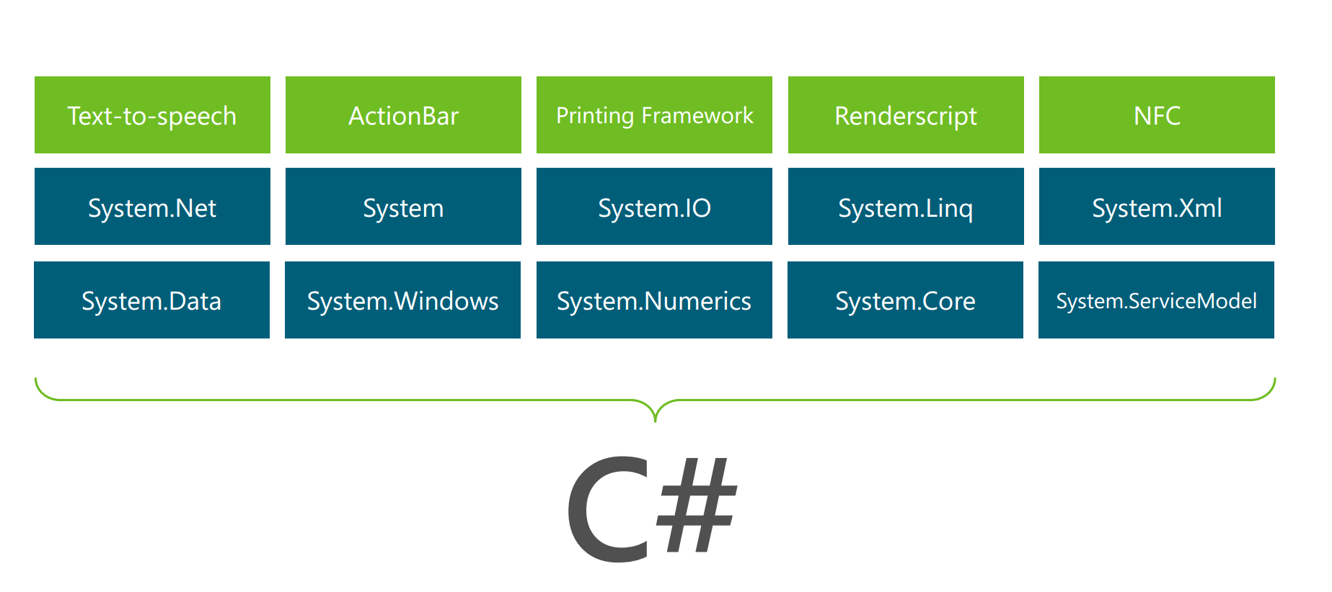
Android – 100% API Coverage

Slide 17
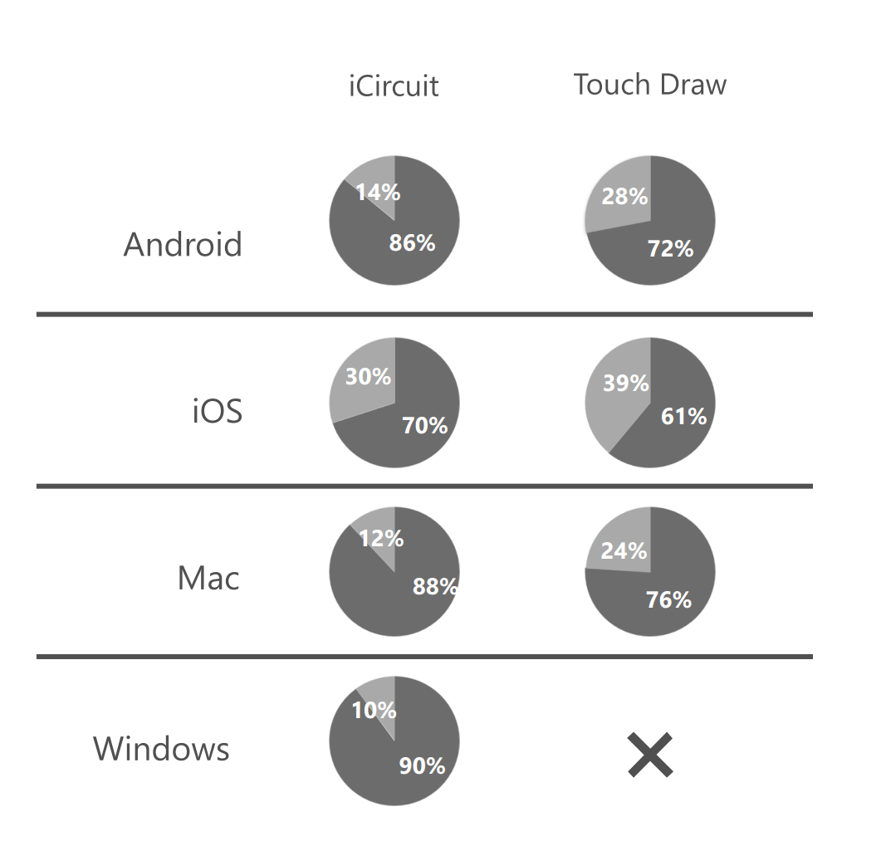
Code sharing stats

Slide 18
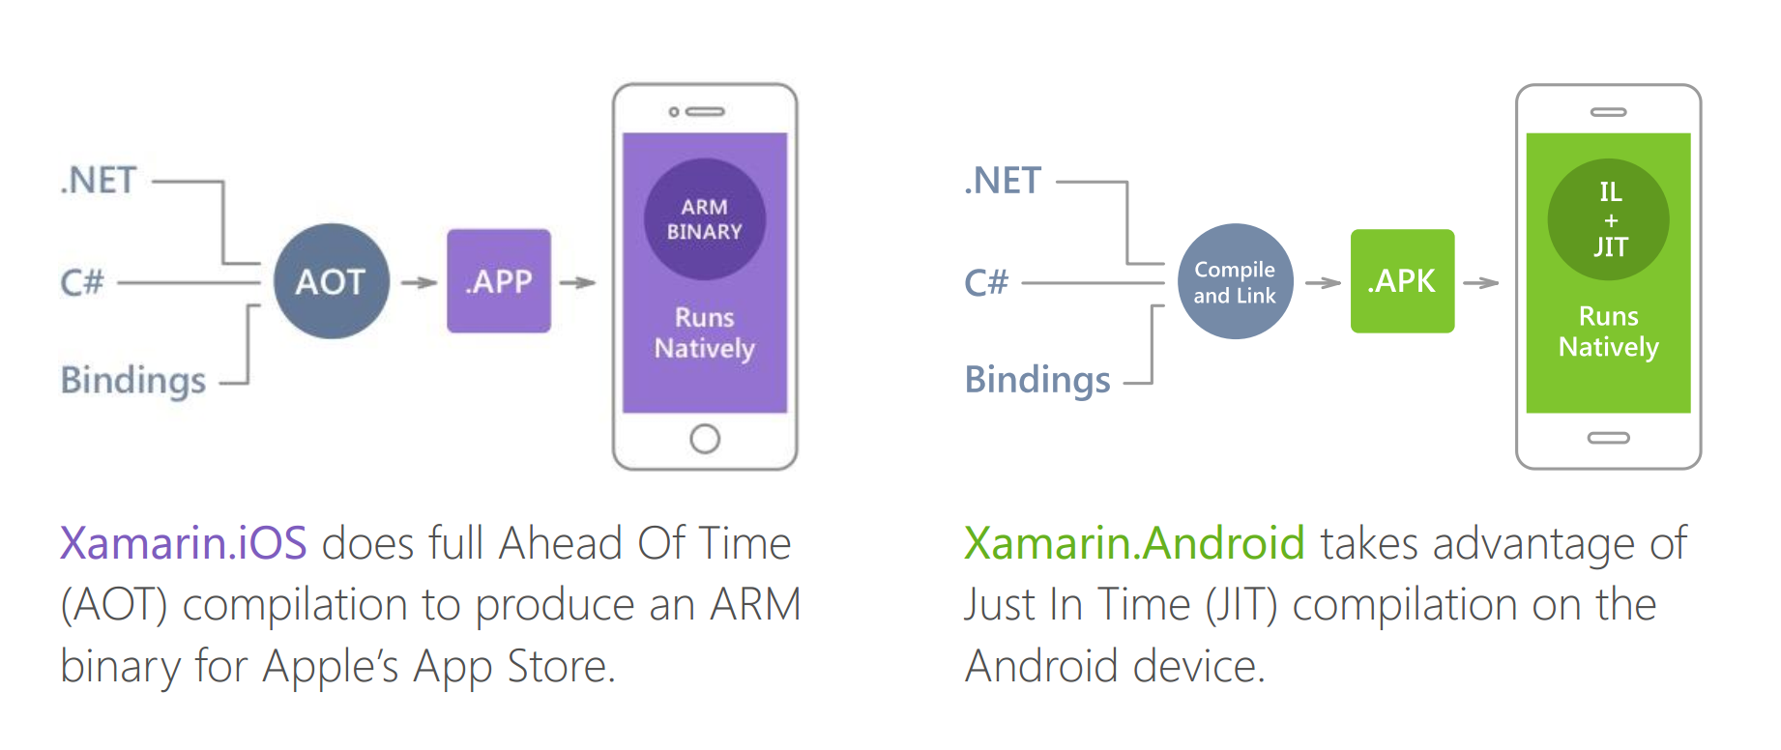
Native Performance

Slide 19
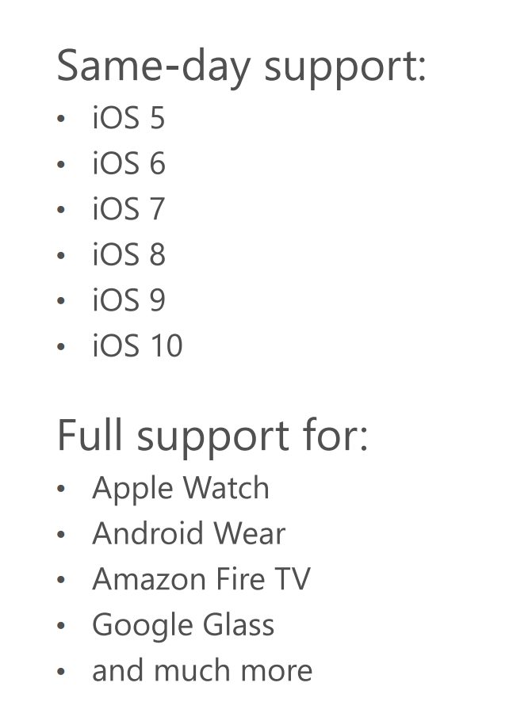
Always up to date

Slide 20
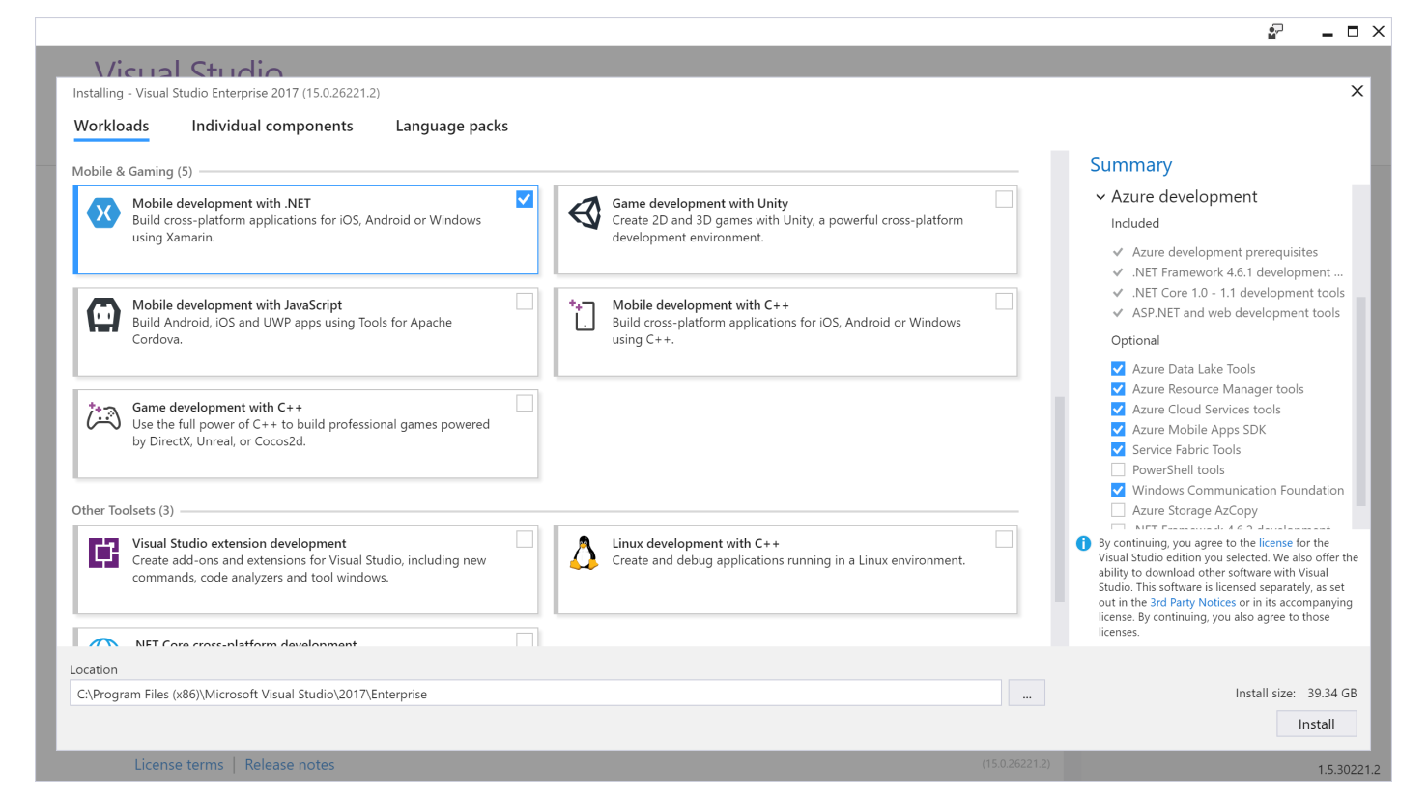
Xamarin for Visual Studio

Slide 21
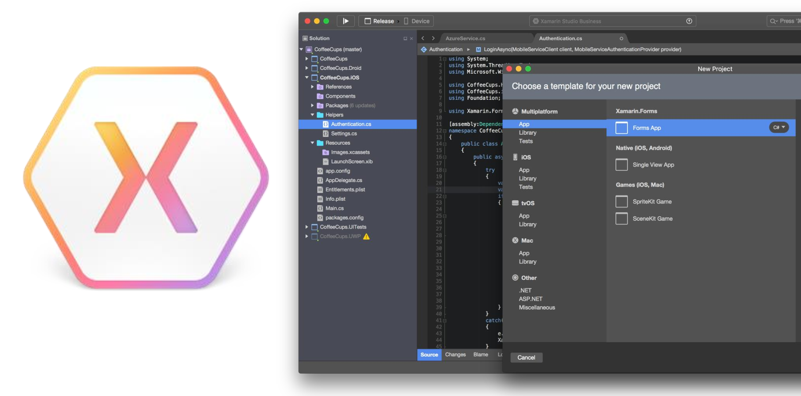
Xamarin Studio - Mac

Slide 22
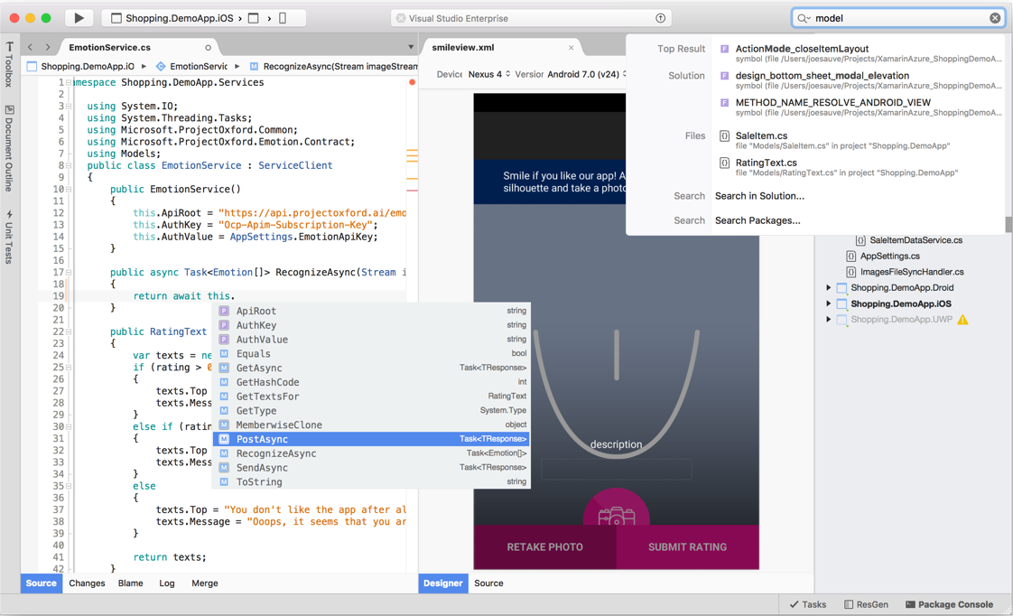
Visual Studio for Mac
iOS/Android/Mac OS
.NET Development
.NET Core & ASP.NET Core
Tools for Azure
https://www.visualstudio.com/vs/visual-studio-mac/

Slide 23
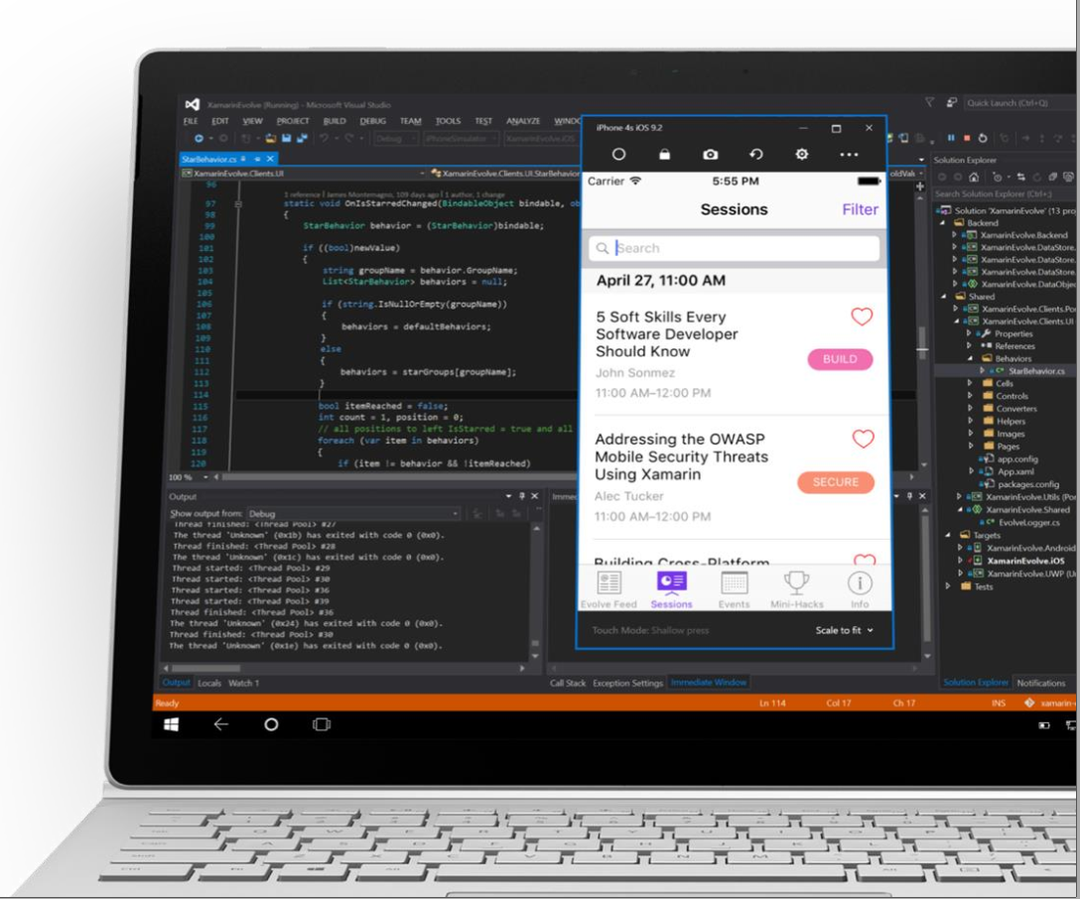
Visual Studio iOS Simulator Remoting
Multi-Touch Enabled
Pressure Sensitive
Rotate, screenshots, location changes
Never leave VS
* Requires Visual Studio Enterprise

Slide 24
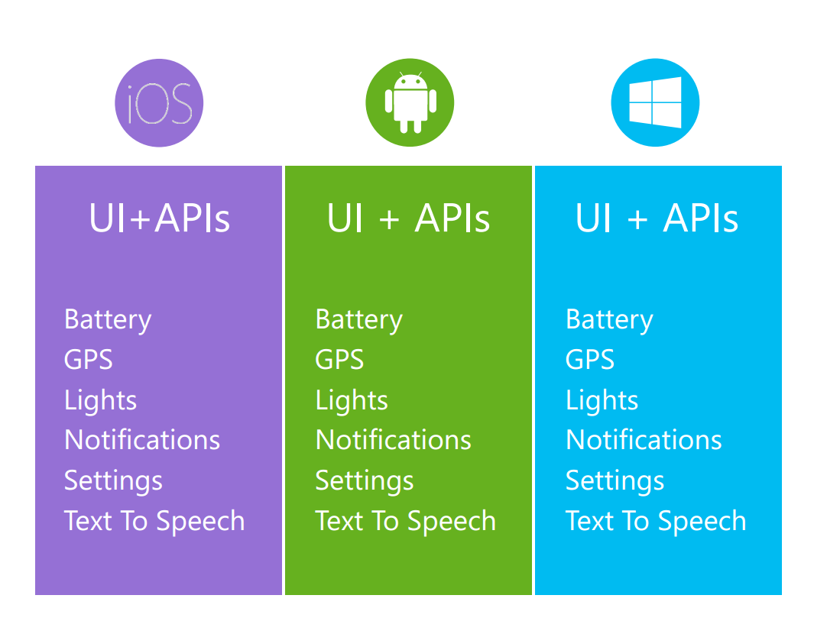
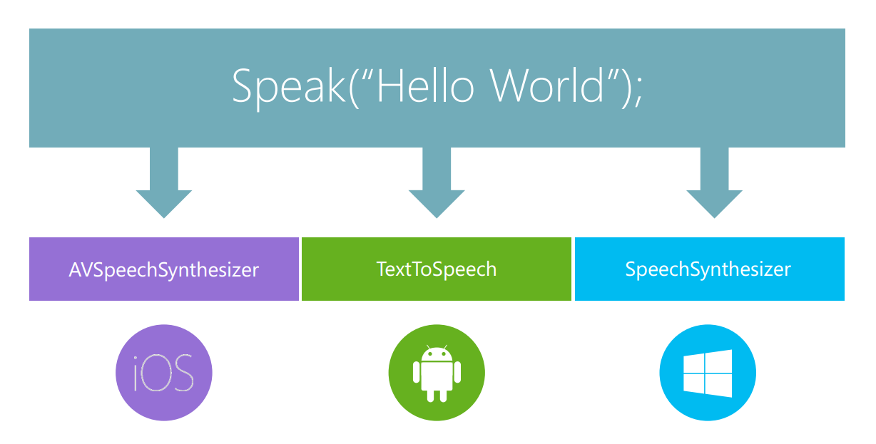
Platform Specific Code

Slide 25

Plugins for Xamarin
github.com/xamarin/plugins

Slide 26
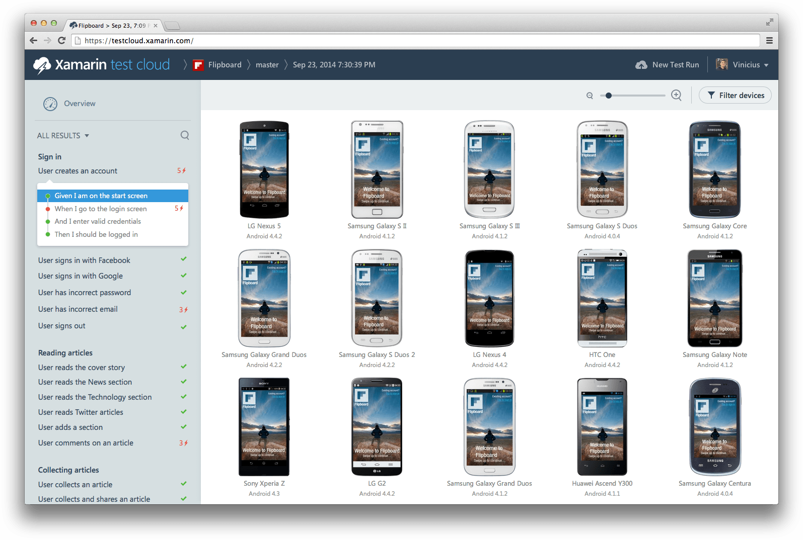
Xamarin Test Cloud: Testing on Real Devices

Slide 27


Continuously Product Improvements
Distribute app to beta users
Monitor your app’s health
Understand your users
Measure adoption and usage
Quickly resolve app crashes
Continuous Integration & Delivery

Slide 28
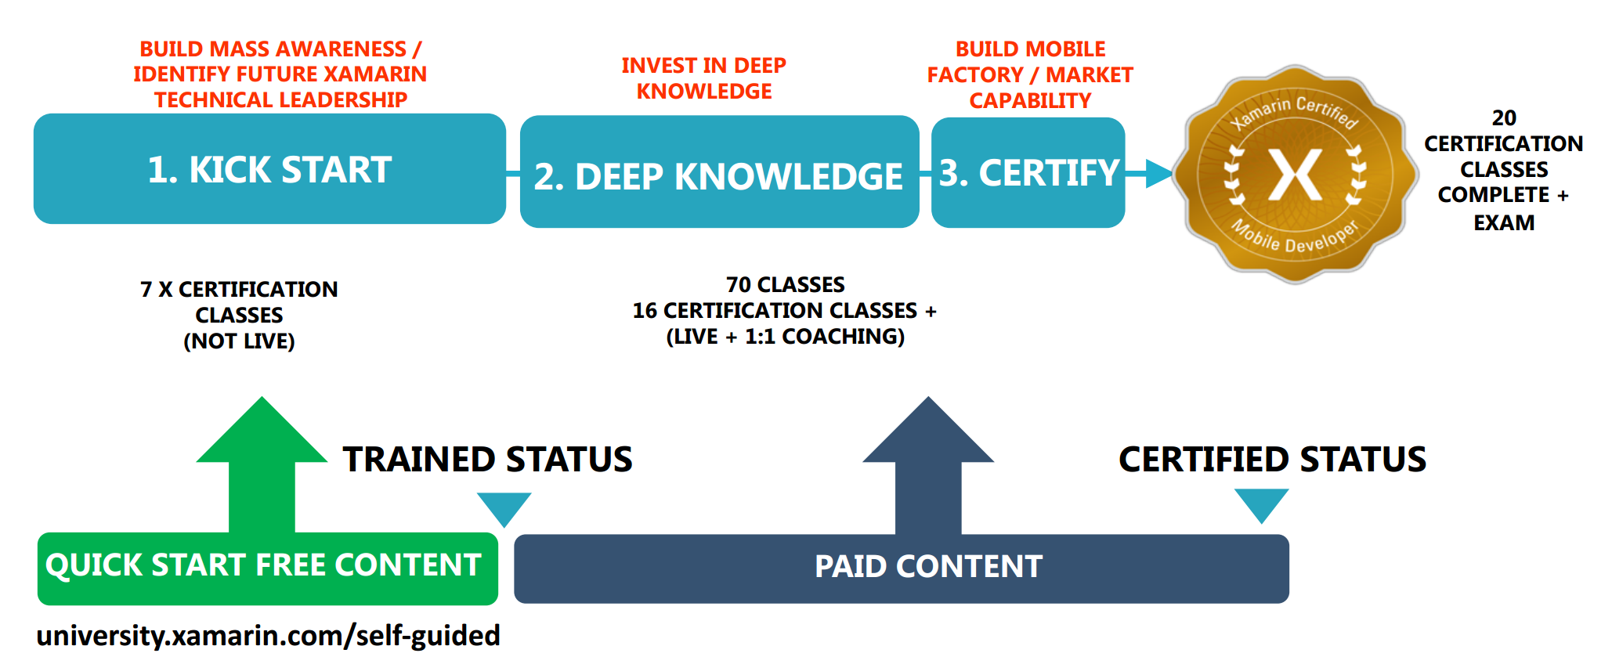
Xamarin University

Slide 29
Visual Studio Mobile Center (Preview)
Provides Mobile Center Xamarin SDK for Xamarin.iOS, Xamarin.Android, Xamarin.Forms (iOS and Android), supports apps developed on Xamarin, Java, Objective-C, Swift и React Native.
using Microsoft.Azure.Mobile;
using Microsoft.Azure.Mobile.Analytics;
using Microsoft.Azure.Mobile.Crashes;
MobileCenter.Start(typeof(Analytics), typeof(Crashes));
https://www.visualstudio.com/vs/mobile-center/

Slide 30
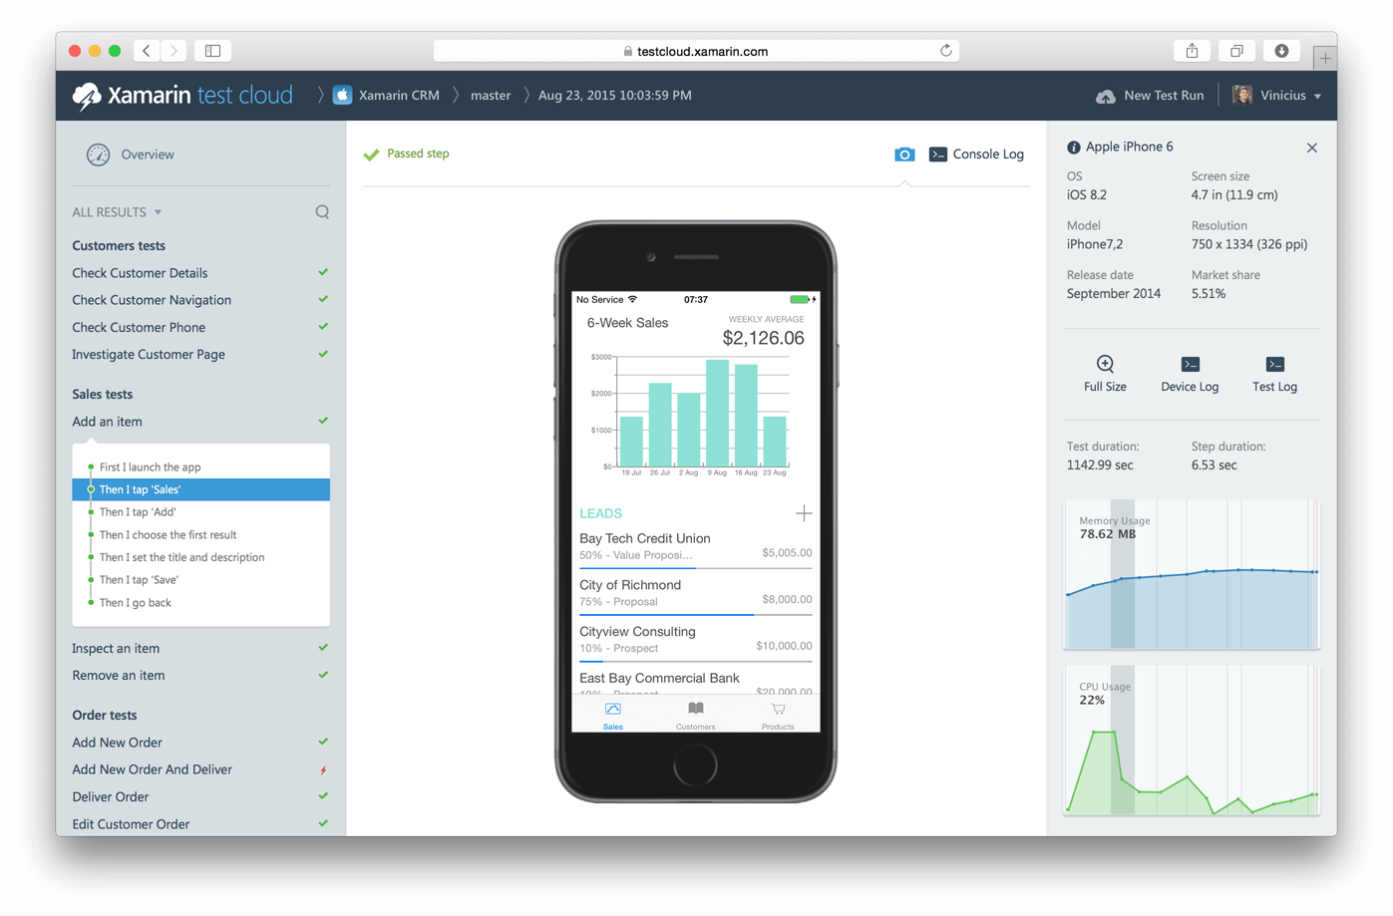

Appium in Xamarin Test Cloud
Ability for Java developers to test apps on real devices with 400+ configurations.

Slide 31
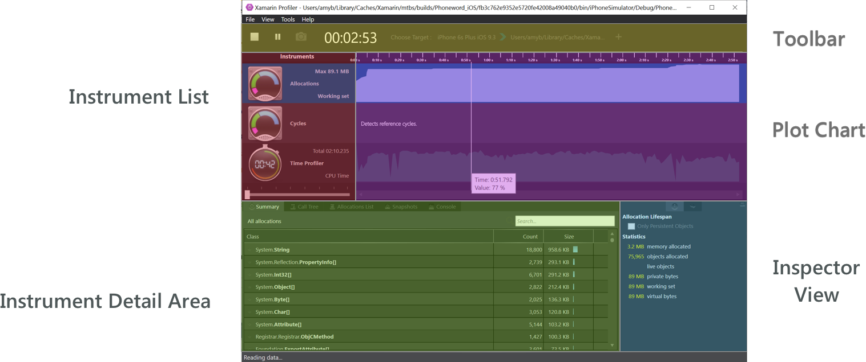
Xamarin Profiler
https://developer.xamarin.com/guides/cross-platform/profiler/

Slide 32
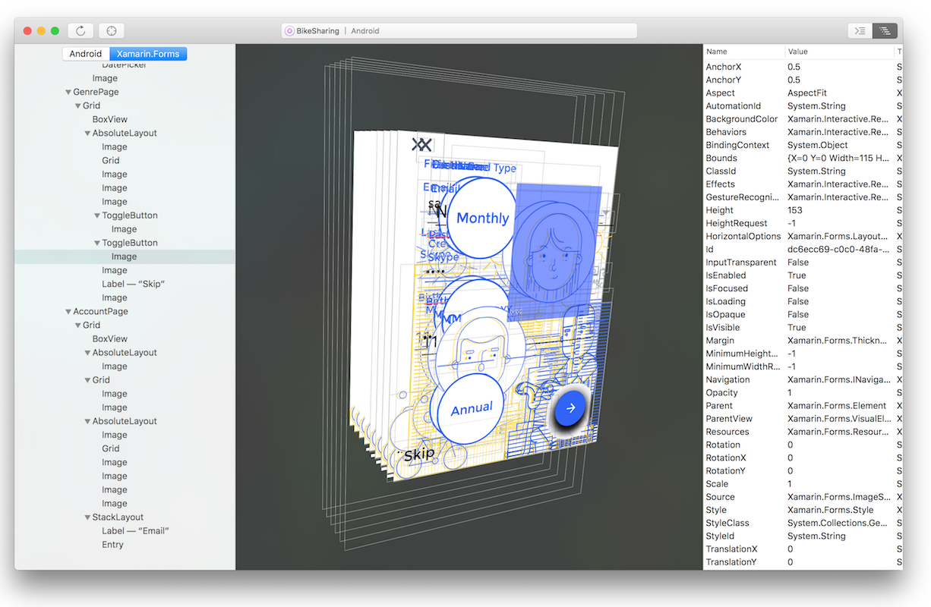
Xamarin Inspector
The Inspector integrates with the app debugging workflow of your IDE, serving as a debugging or diagnostics aid when inspecting your running app.
https://developer.xamarin.com/guides/cross-platform/inspector/

Slide 33
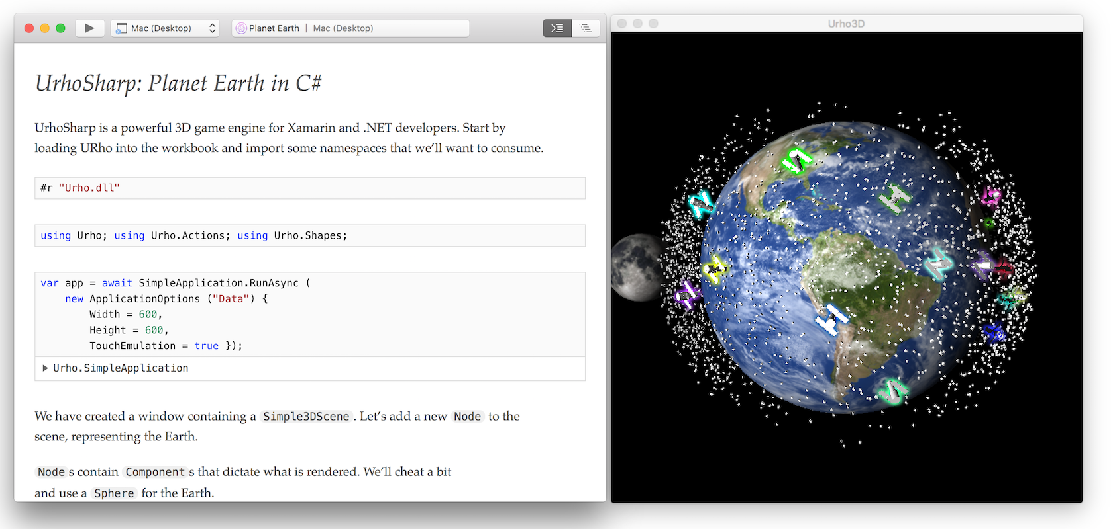
Xamarin Workbooks
A blend of documentation and code that is perfect for experimentation, learning, and creating guides and teaching aids.
https://developer.xamarin.com/guides/cross-platform/workbooks/

Slide 34
Xamarin.Forms 3.0
Xamarin.Forms Embedding Take any ContentPage in XAML or C# and embed it directly into a Xamarin.iOS, Xamarin.Android, or UWP application.
Reach More Platforms macOS, Linux, WPF
Speed Boosts and Enhancements
Introducing XAML Standard
https://blog.xamarin.com/glimpse-future-xamarin-forms-3-0/

Slide 35
Xamarin Ukraine Telegram Chat
https://t.me/xamarin_ukraine

Slide 36
Q&A
Alex.Krakovetskiy@devrain.com
@msugvnua

Slide 37
Connected & Disconnected Apps with Azure Mobile Apps Oleksandr Krakovetskyi CEO, DevRain Solutions @msugvnua, alex.krakovetskiy@devrain.com

Slide 38
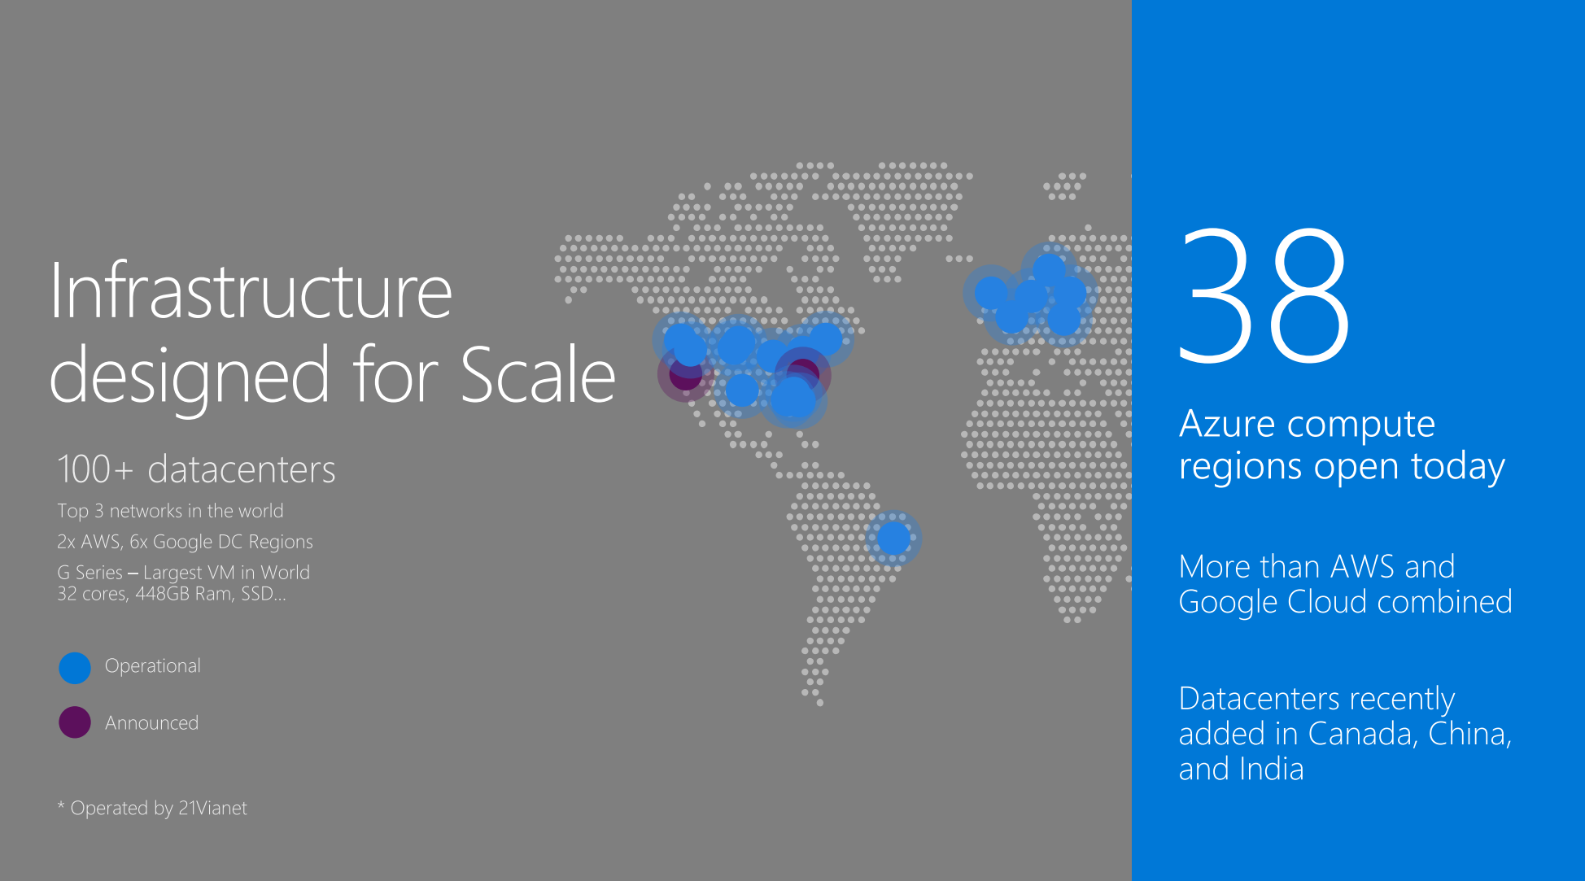

Slide 39
Azure Mobile Apps
Powerful
Flexible
Easy Tables (Node.js Backend)
App Service (ASP.NET Backend)
Cross-platform client SDK
iOS, Android, and Windows
Open source C#
Backend and client SDKs on Github

Slide 40
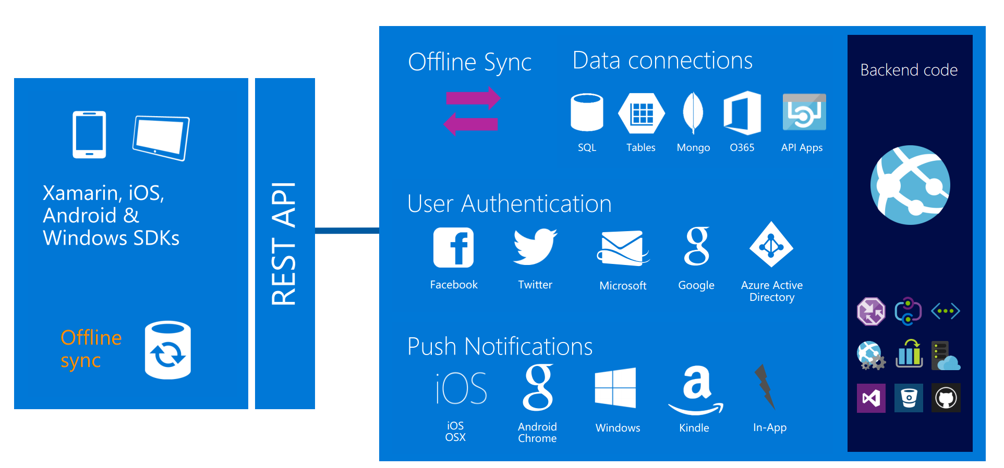
Why Azure Mobile Apps?

Slide 41
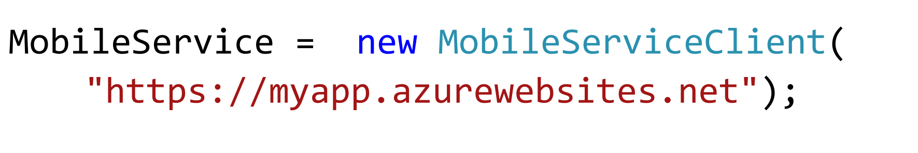
Create a Mobile Service

Slide 42
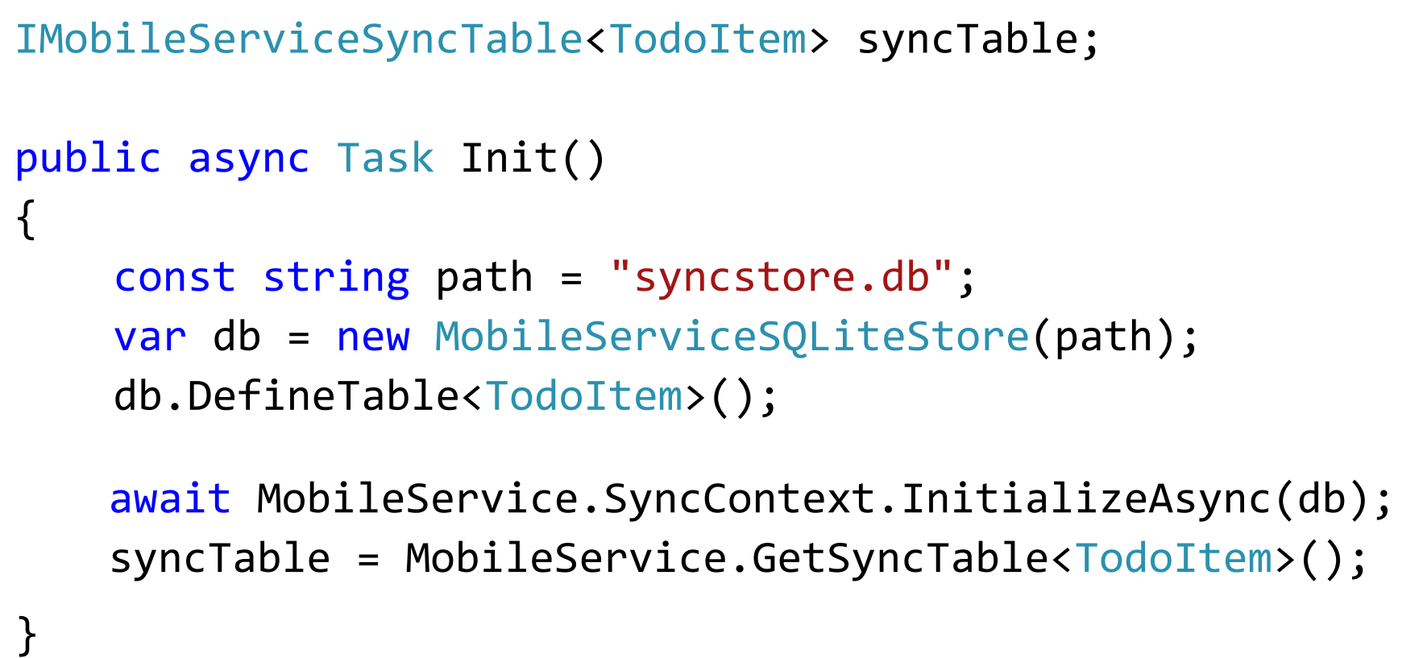
Create tables

Slide 43
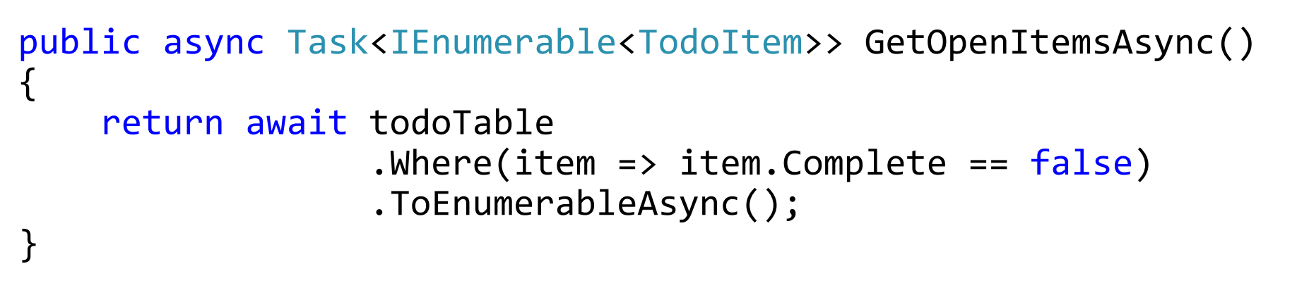
Query local table

Slide 44
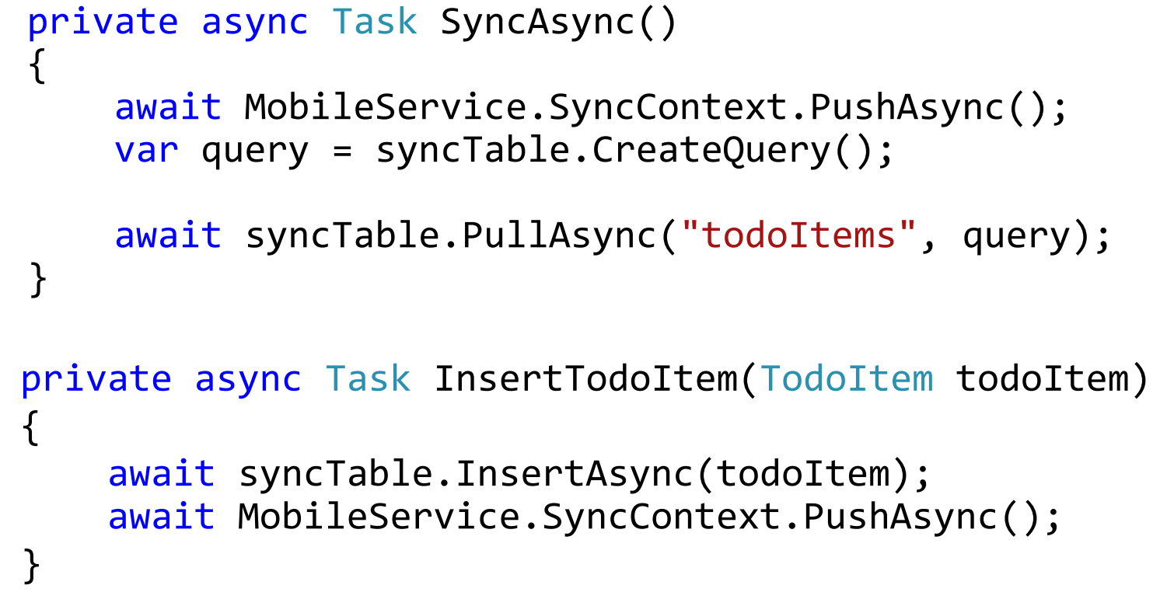
Push and pull with sync table

Slide 45
User authentication
Facebook
Twitter
Google
Microsoft
Azure AD
Anything OAuth 2

Slide 46
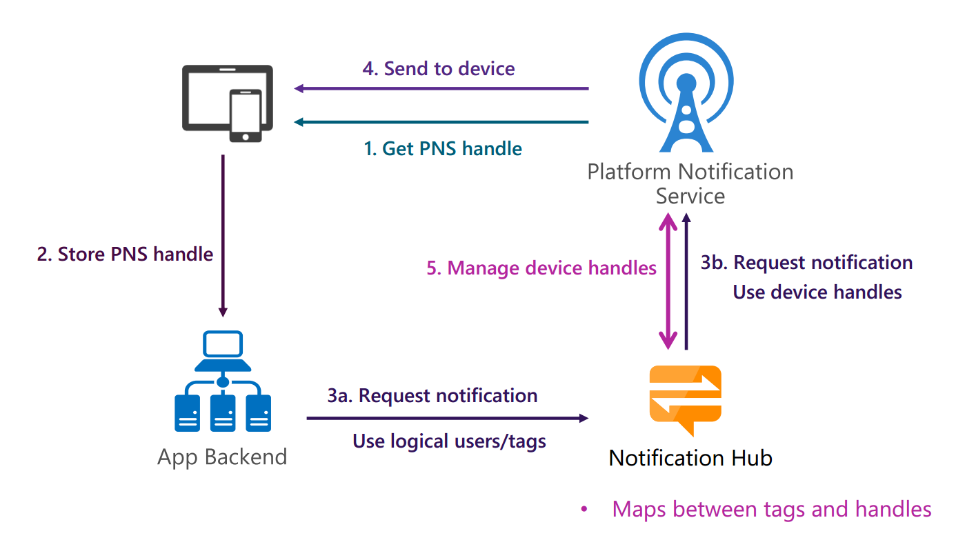
Push notifications Notification Hub

Slide 47
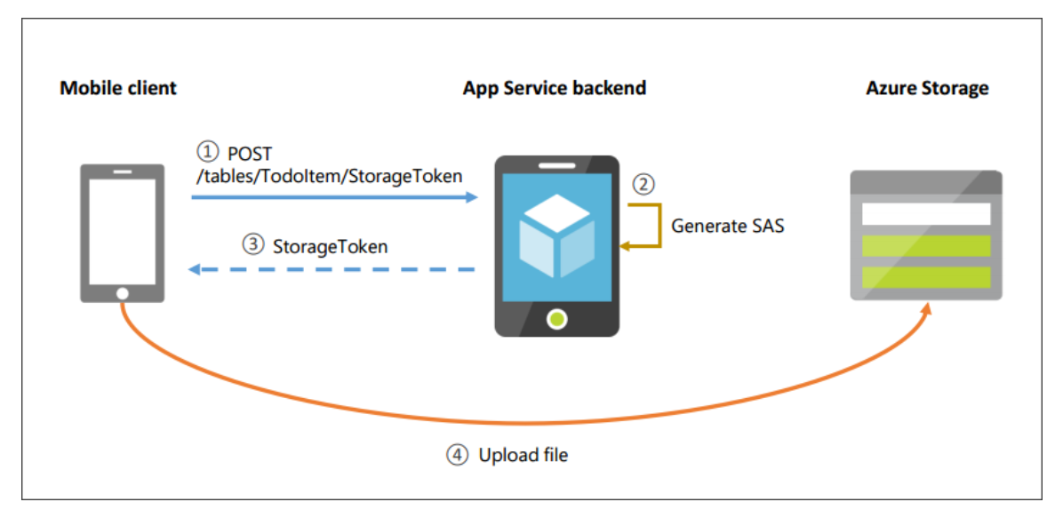
File sync
Sync files to Azure Storage
Online/Offline

Slide 48
Visual Studio Mobile Center (PREVIEW)
Visual Studio Mobile Center is the next generation of HockeyApp and Xamarin Test Cloud.
Support:
Mobile platforms: Objective-C, Swift, Java, Xamarin, React Native, UWP
Lifecycle features: Build, Test, Distribution, Analytics, Crashes
Cloud features: Push notifications
https://www.visualstudio.com/vs/mobile-center/

Slide 49
Azure Cognitive Services
Put intelligence APIs to work
Vision
Speech
Language
Knowledge
Search
Labs
https://azure.microsoft.com/en-us/services/cognitive-services/

Slide 50
Q&A
Alex.Krakovetskiy@devrain.com
@msugvnua

